Slide 1
LAW CONNECT
Team Name : SPARK CODERS

Slide 2

LAW CONNECT
Solution Overview
Connects citizens with verified lawyers for cases & legal tasks
AI chatbot to explain rights & legal processes
Lawyers have professional profiles & networking
Case tracking dashboard for real-time updates
Supports court & non-court services (notary, agreements, contracts)
Innovation & Uniqueness
AI lawyer-matching system + Professional Networking
for lawyers
Timeline-style case tracking (like delivery apps)
Multilingual & accessible for wider population
Historical Outcome Tracking
How It Solves the Problem
Best-fit lawyer matching → reduces financial loss
Transparent ratings + professional credibility
Case updates & peer-verified profiles
Educates citizens on rights

Slide 3
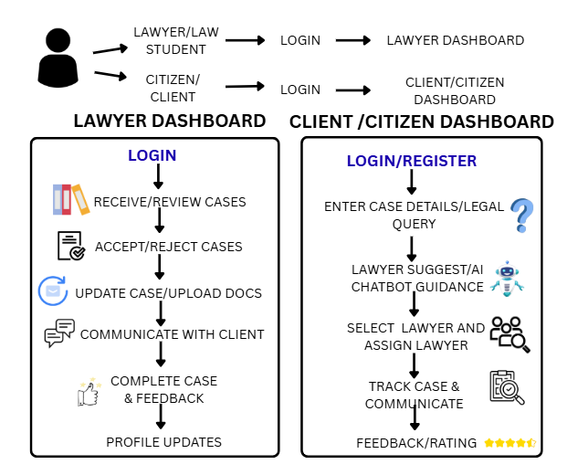
TECHNICAL APPROACH
Technologies to Be Used:
Frontend (App & Web):
Flutter → cross-platform mobile apps
React.js → web dashboard
Backend & Database:
Node.js + Express → server-side logic
MongoDB / PostgreSQL → storing user, lawyer, and case data
Firebase / AWS → push notifications & authentication
AI & NLP:
GPT-based chatbot → legal queries, citizen guidance
AI lawyer matching → recommends suitable lawyers based on case
type, ratings, experience
Security & Verification:
Encryption for sensitive documents
KYC verification for lawyers and user verification
HTTPS, JWT authentication

Slide 4
FEASIBILITY AND VIABILITY
Feasibility Analysis
Technical: Mobile app with React Native/Flutter, database (Firebase/PostgreSQL), AI chatbot for legal guidance.
Operational: Verified lawyers register; citizens submit cases digitally; case tracking end-to-end.
Economic: Monetization via subscriptions, service fees, or premium AI guidance; high adoption potential in urban areas
Potential Challenges & Risks with Solutions
Lawyer Verification: Check licenses & ID.
Data Privacy: Encryption & compliance.
User Trust: Ratings, reviews, trial consultations.
AI Accuracy: Info only; updated knowledge base.
Scalability:Cloud hosting & scalable backend.
Legal Compliance: Follow local laws, collaborate with authorities.

Slide 5
IMPACT AND BENEFITS
Potential Impact on Target Audience
Citizens: Easy access to verified, experienced lawyers; faster legal resolution; better-informed about rights.
Lawyers: Access to genuine cases; showcase expertise; build client trust.
Society: Increased legal awareness; reduced exploitation due to lack of proper legal guidance.
Benefits of the Solution
Social: Empowers citizens, improves transparency, enhances trust in legal services.
Economic: Saves time and money by connecting users with the right lawyers; potential revenue for lawyers.
Operational: Streamlines case management and lawyer-client communication.

Slide 6
RESEARCH AND REFERENCES
Aspect | Existing Websites / System | Legal Buddy (Proposed App)
Finding Lawyers | Websites: Basic info, no ratingsOffline: Manual search, unverified sources | Verified database with specialization, experience, ratings
Case Guidance | Websites: Articles/FAQs, not personalizedOffline: Limited knowledge, costly consultations | AI chatbot provides personalized legal guidance
Case Tracking | Websites: Not supportedOffline: Follow-ups needed | Real-time case status for citizens and lawyers
Trust & Transparency | Websites: No reviews or verificationOffline: Minimal info on lawyer performance | Ratings, reviews, verified profiles ensure trust
Non-Court Legal Work | Websites: Limited coverageOffline: Hard to find lawyers for agreements/notary | Supports both court and non-court legal services

